Slide 1
NEVADA EXCELLENCE IN MINE RECLAMATION AWARDS 2024
Nevada Mining Association Awards Presentation
September 6, 2024
Rob Ghiglieri – Nevada Division of Minerals

Slide 2
NEVADA EXCELLENCE IN MINE RECLAMATION AWARDS
Awards Program began in 1991
Purpose: “to recognize and share examples of successes in the areas of reclamation, closure, planning, and wildlife protection and enhancement in Nevada”
Qualifications for an award:
Excellent mitigation of the environmental impacts of mineral industry activity
Work efforts which go above and beyond what is mandated
Worthy examples to share with others in the industry
Awards require unanimous approval from Committee

Slide 3
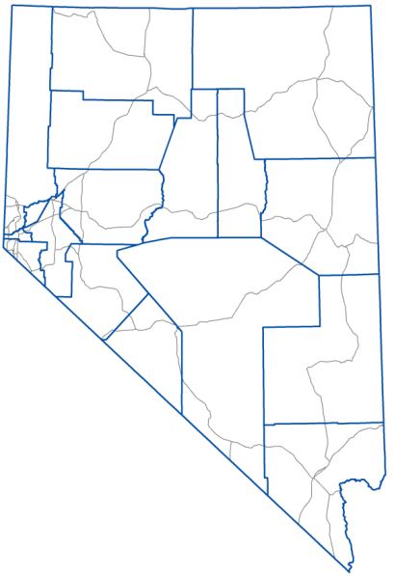
2024 Nevada Excellence in Mine Reclamation
Kinross Gold Corporation
Bald Mountain Mine
White Pine County
Phase 1 Heap Leach Facility
Reclamation Project
Award Category:
Leadership in Concurrent Reclamation

Slide 4
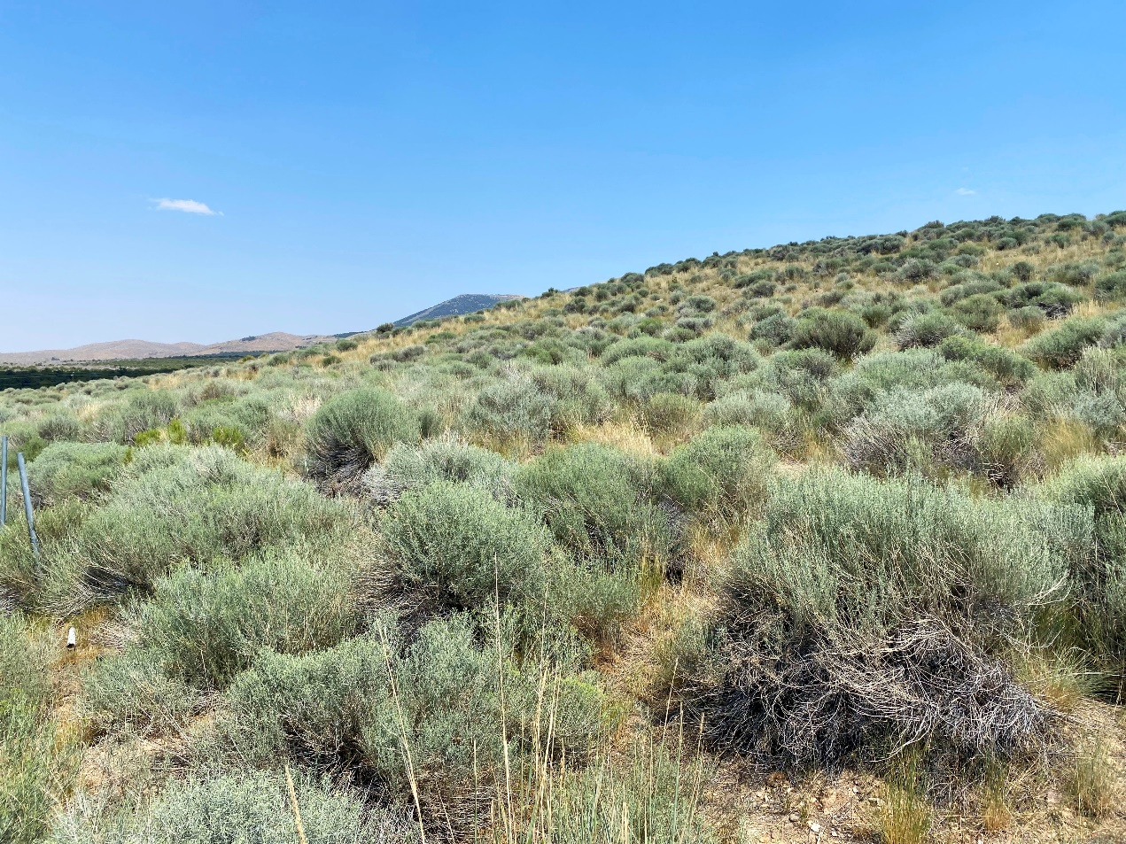
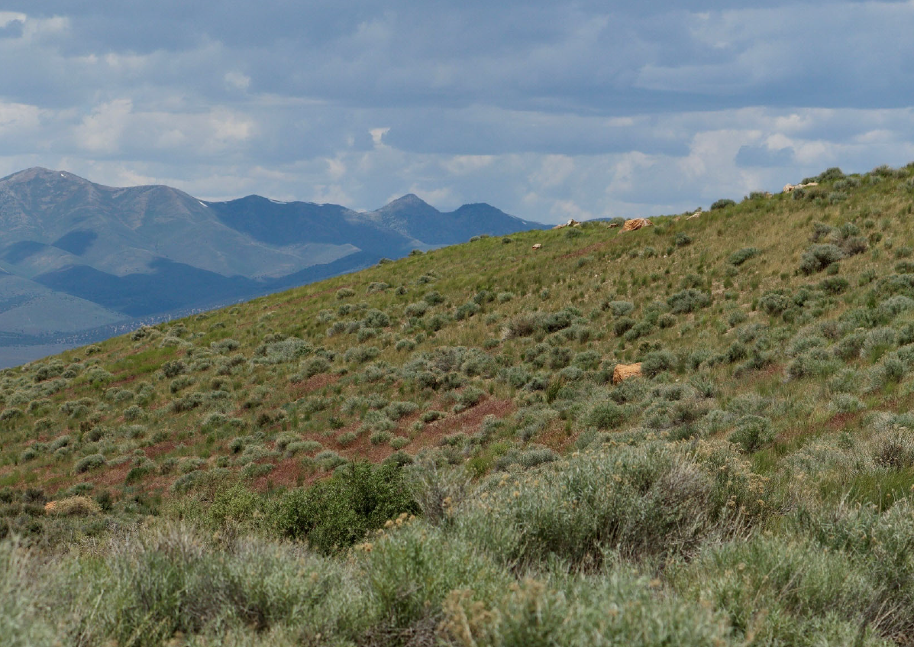
Kinross Gold Corporation
Bald Mountain Mine
90-acre pad that operated from 1983-1998
Decades of planning, execution and monitoring
Continuous improvements to water over life of reclamation.
Extensive use by wildlife
The 2022 / 2023 winter produced 300% snowpack with no adverse effects

Slide 5
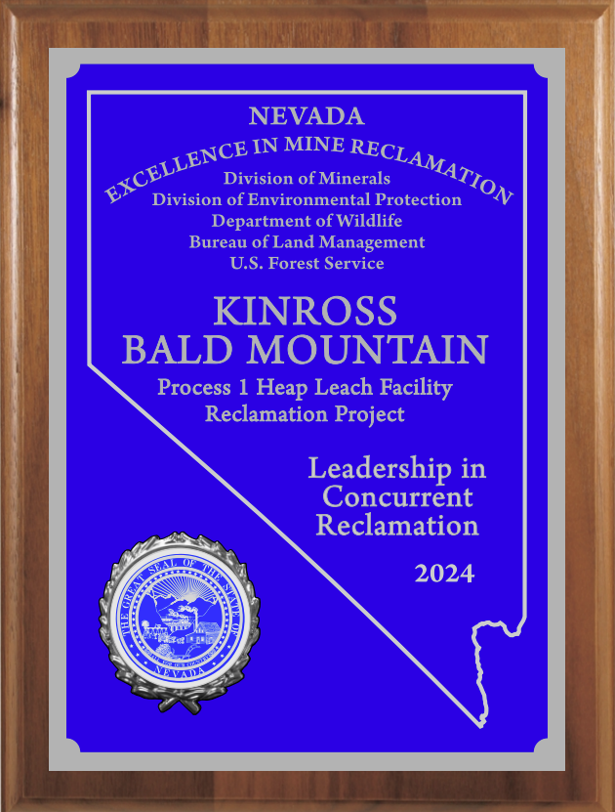
Accepting the 2024 award for Kinross Gold Corporation
Madison Hughes,
Environmental Engineer

Slide 6
2024 Nevada Excellence in Mine Reclamation Award
Coeur Mining Inc
Rochester Mine
Pershing County
Duffy Pond Restoration Project
Award Category:
Wildlife Habitat Restoration

Slide 7
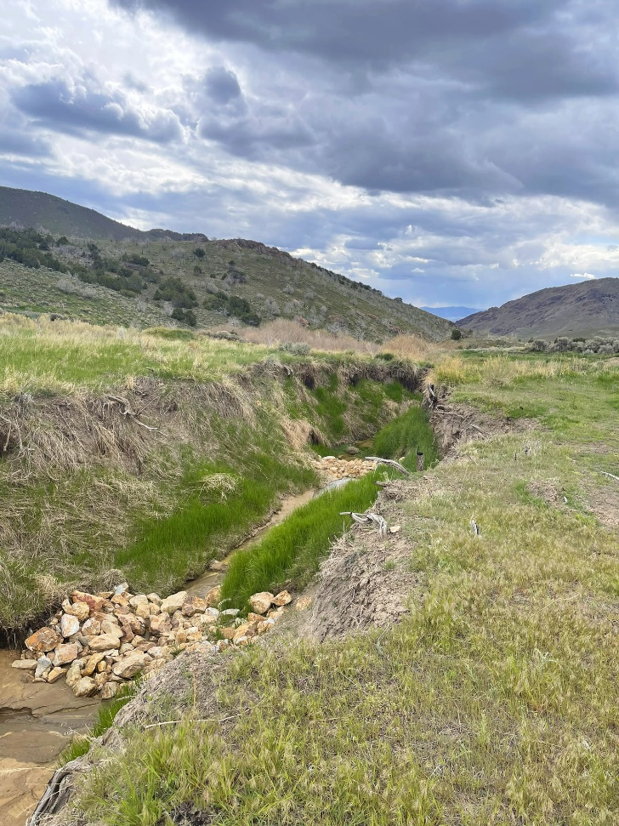
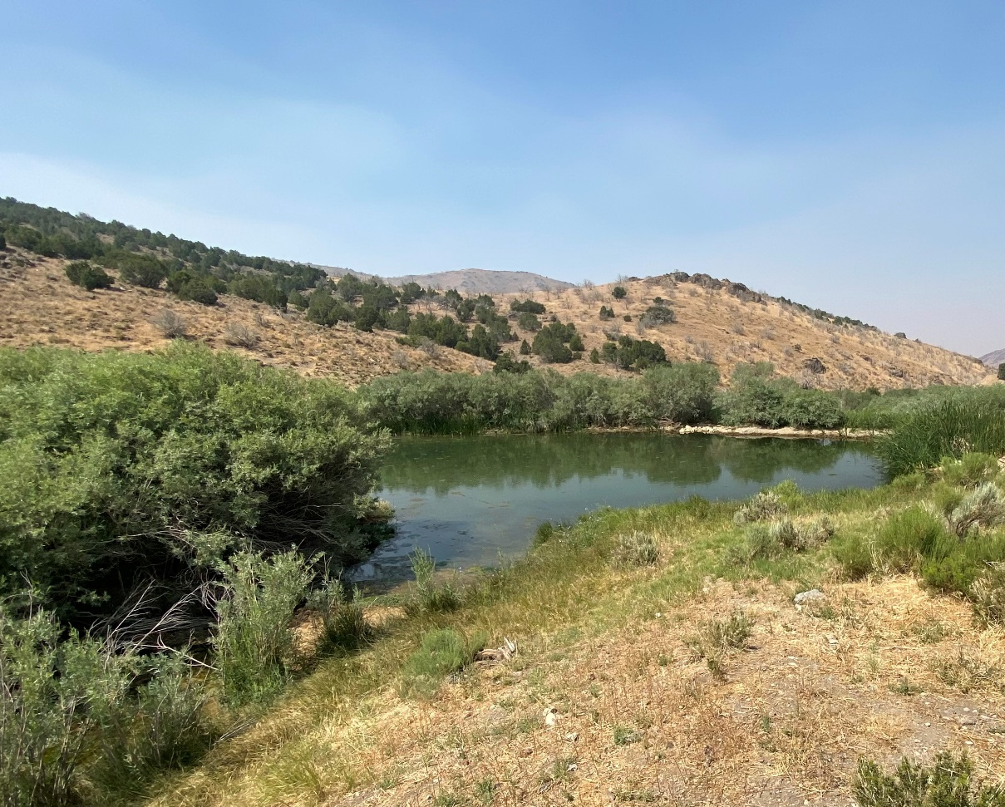
Coeur Mining Inc
Duffy Pond Restoration Project
Not required under any permit
Extensive use by wildlife
Significant wildfires impacting surrounding area
Engineered designs to not only restore but also improve the habitat to limit potential future damage.

Slide 8
Accepting the 2024 award for Coeur Mining Inc
Gina Hawkins | Senior Environmental Coordinator
Katie Heazlett | Environmental Manager
John Jones | Process Supervisor
Tony Booth | Project Supervisor
Frankie Graham | Senior Community Relations Specialist

Slide 9
On behalf of the Awards Committee, thank you to all that submitted nominations and congratulations to our award winners.
Next year’s submissions are due by May 30th, 2025

