Slide 1
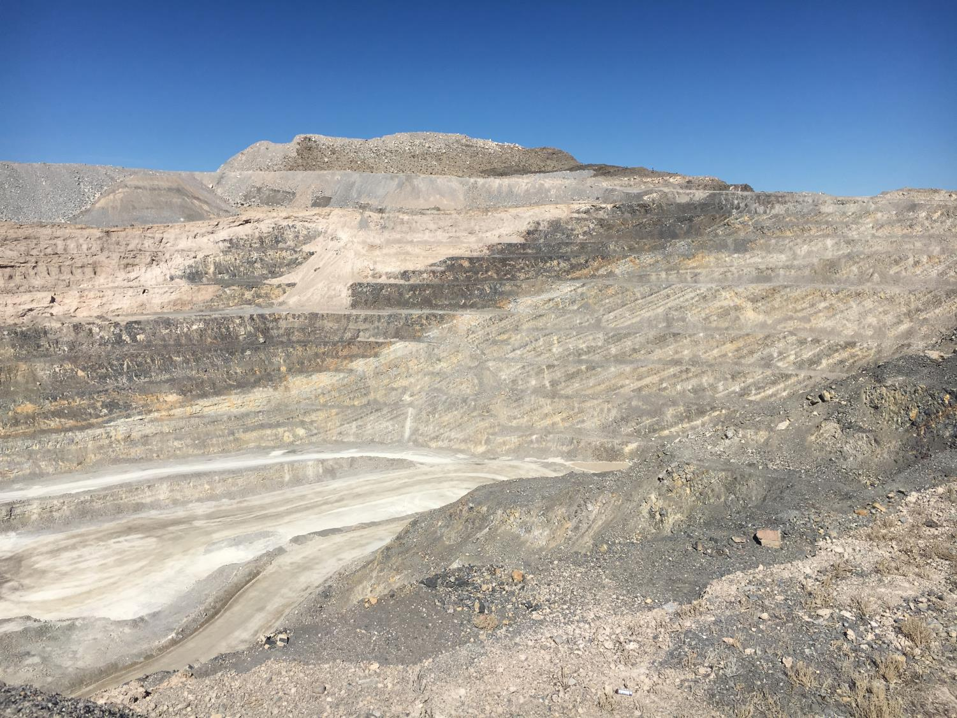


Nevada Division of Minerals
2016 NEVADA MINERAL PRODUCTION AND NDOM ACTIVITIES
NEVADA MINING ASSOCIATION BOARD MEETING
May 11, 2017
Mike Visher, Deputy Administrator

Slide 2
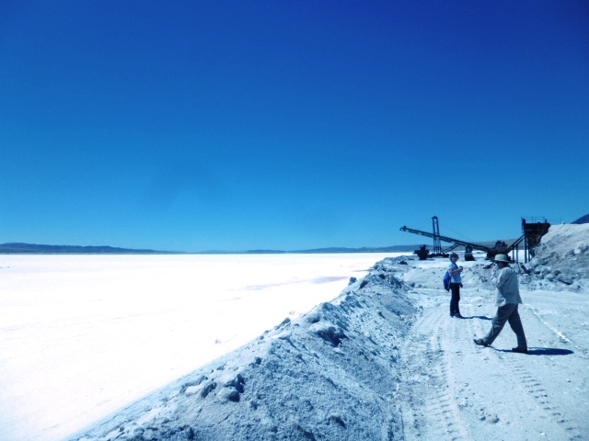
NDOM – what we do by statute
  NRS 513
    Abandoned Mine Lands Program,
    Public information and minerals education
    Annual mineral, geothermal and oil production reporting and maps
    Advise and recommend mineral policy to Governor and Legislature (act as cooperating State agency on Federal Land withdrawals & NEPA actions when requested)

Slide 3
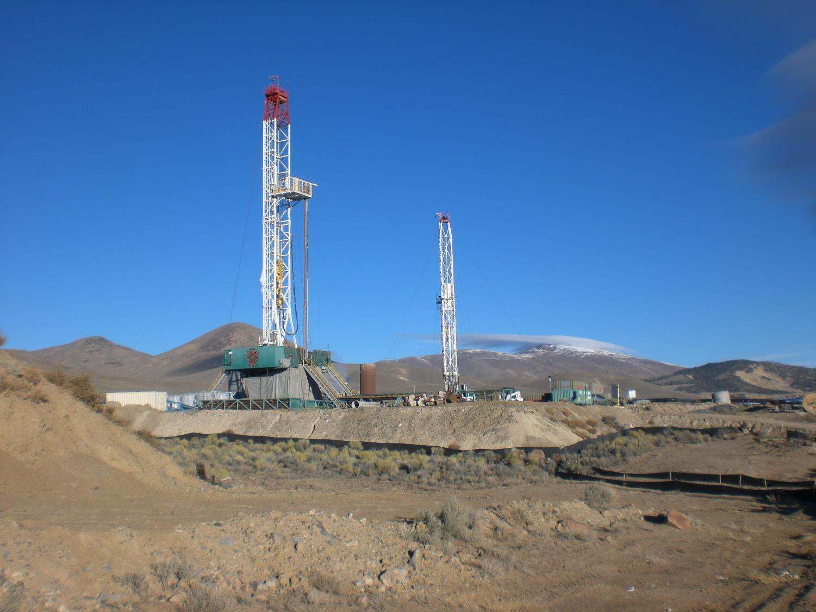
NDOM – what we do by statute
  NRS 517: Mining Claims, Mill sites and Tunnel rights
  NRS 519A.290: State Reclamation Bond Pool
  NRS 522 Oil and Gas
    Well permitting, drilling, completion compliance, conservation of resource, correlative rights resolution
  NRS 534A : Geothermal Resources
    Well permitting, drilling, completion compliance, conservation of resource

Slide 4
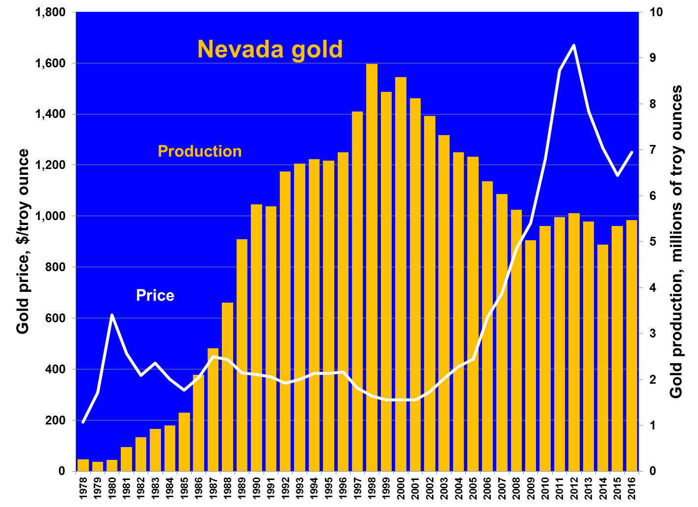
2016
5.47 M. ozs
+2.4% vs ‘15
33 operations
22 producers

Slide 5
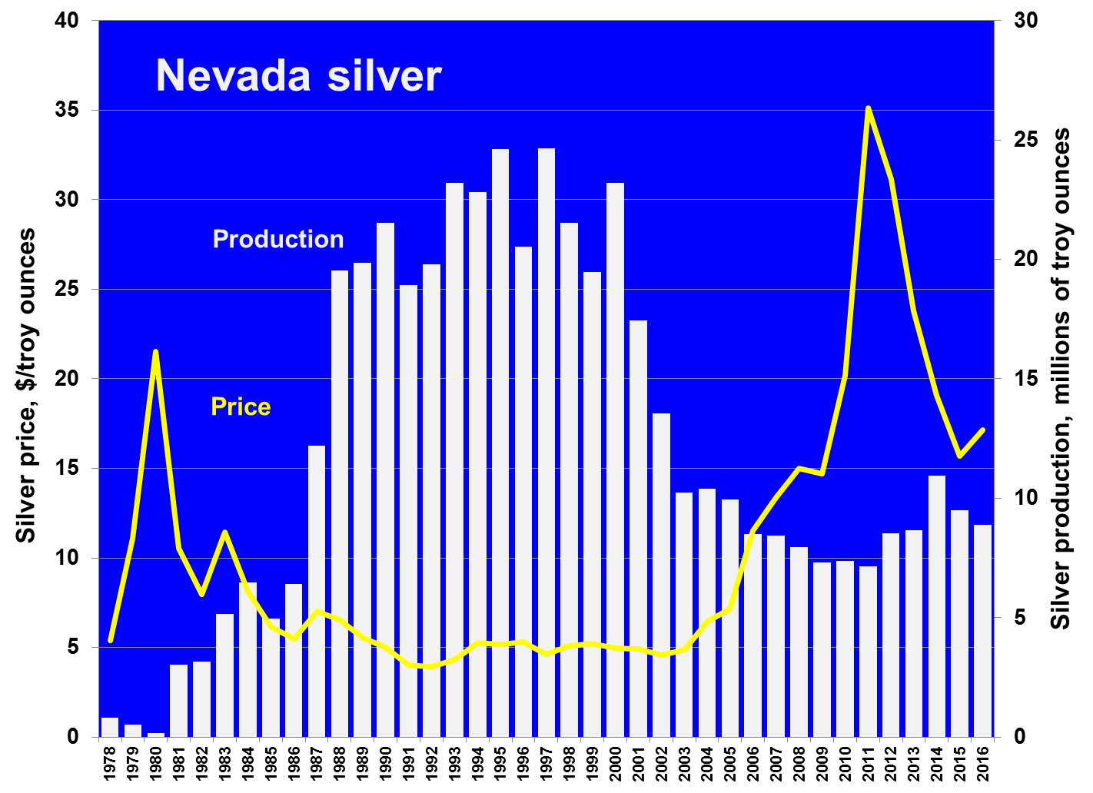
2016
8.89 M. ozs.
-6% vs ‘15
23 operations
16 producers

Slide 7
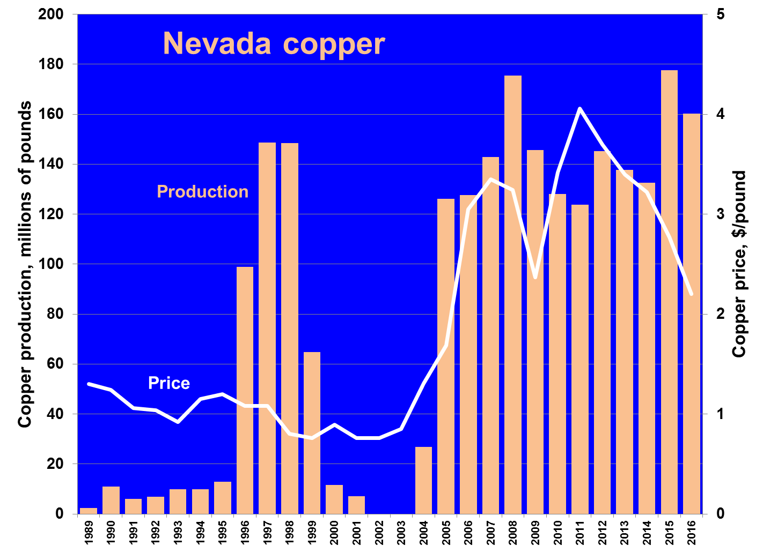
2016
177 M. lbs.
-10 % vs. ‘15
2 producers

Slide 8
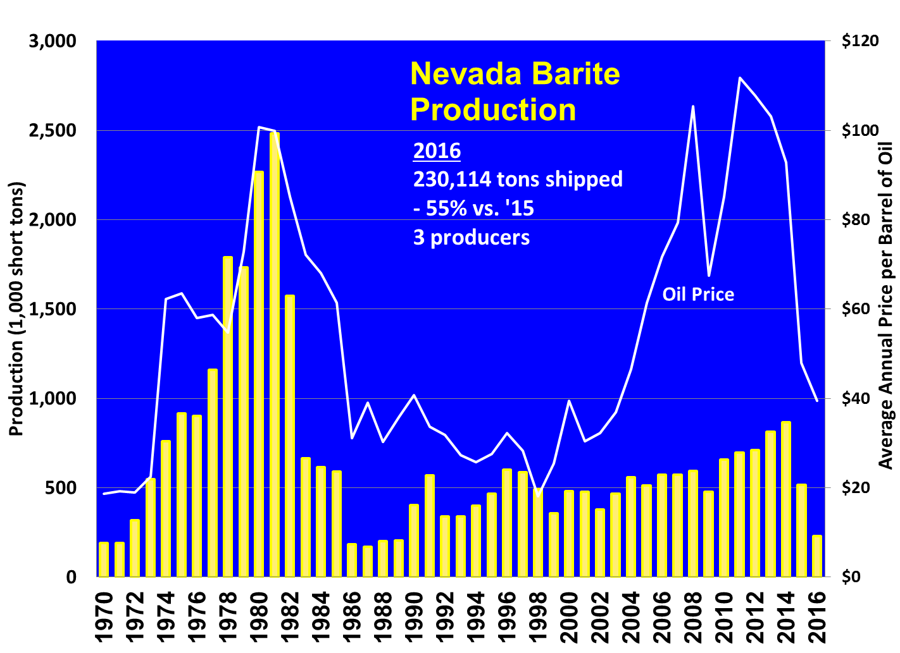

Slide 9
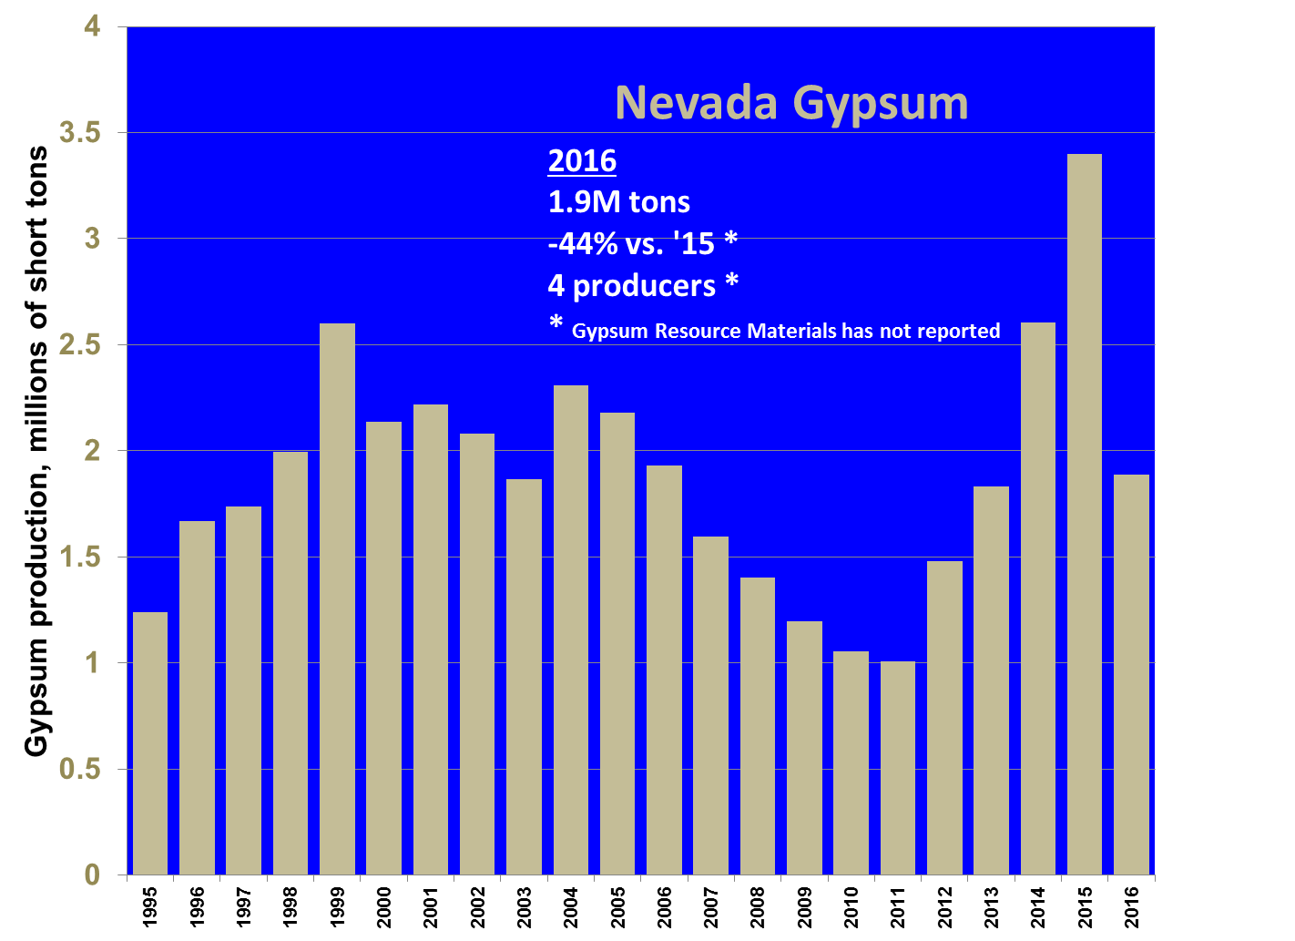

Slide 10
Other Industrial Minerals Produced, 2016 - draft
9,334,629 lbs of lithium compounds
110,000 tons of magnesium compounds
240,654 tons of diatomaceous earth
1,000,000 tons of silica products
19,110 tons of salt

Slide 11
-7.1%

Slide 13
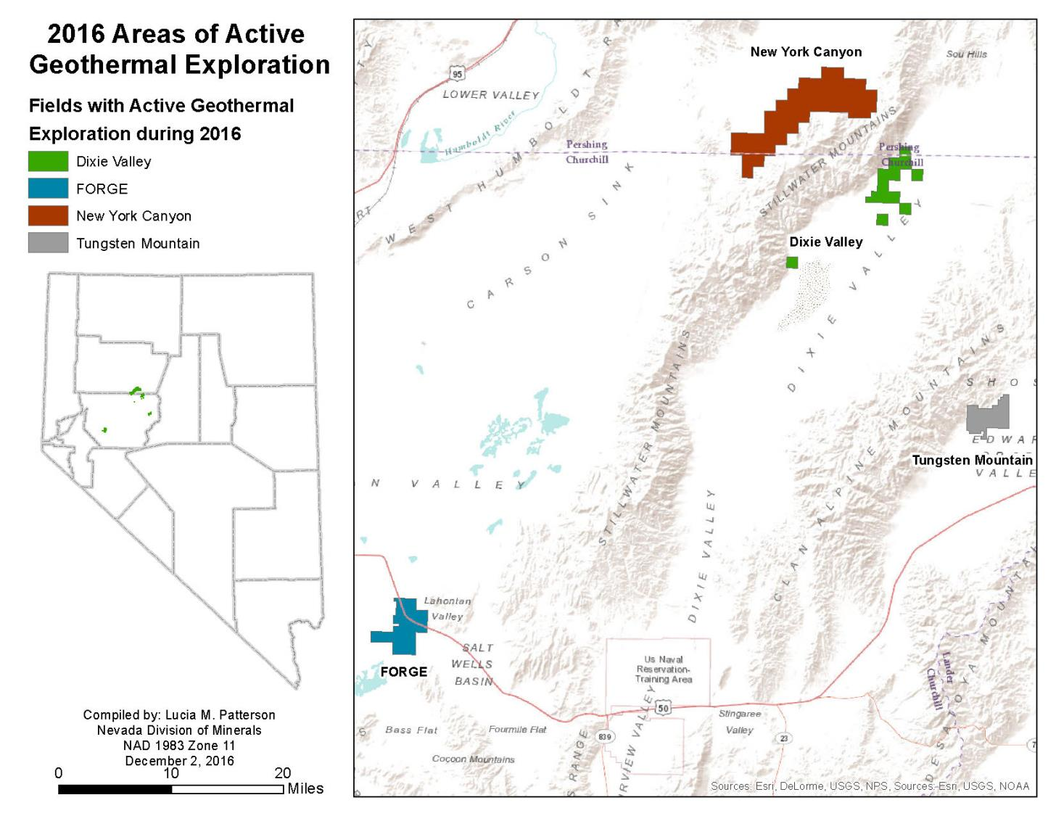

Slide 15
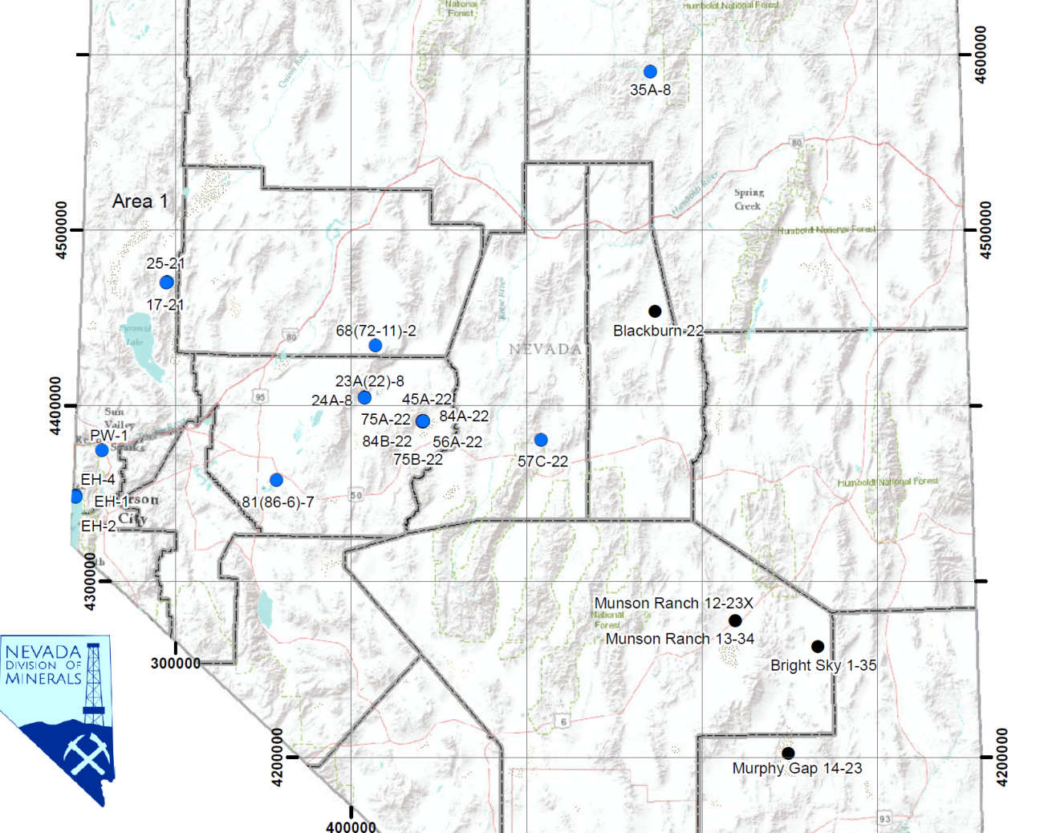
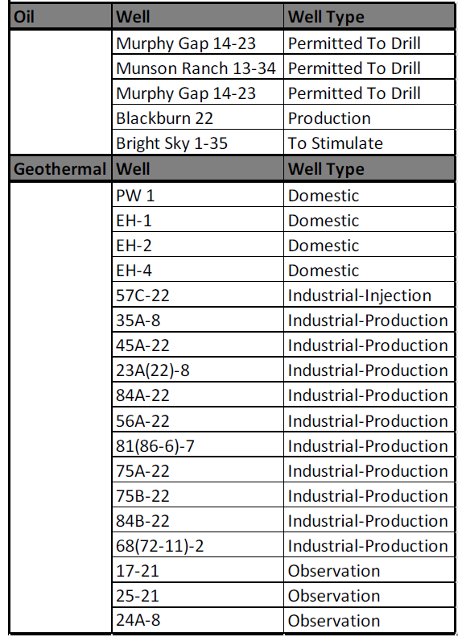
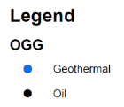
2016 Nevada Oil, Gas, & Geothermal Drilling Activity

Slide 16
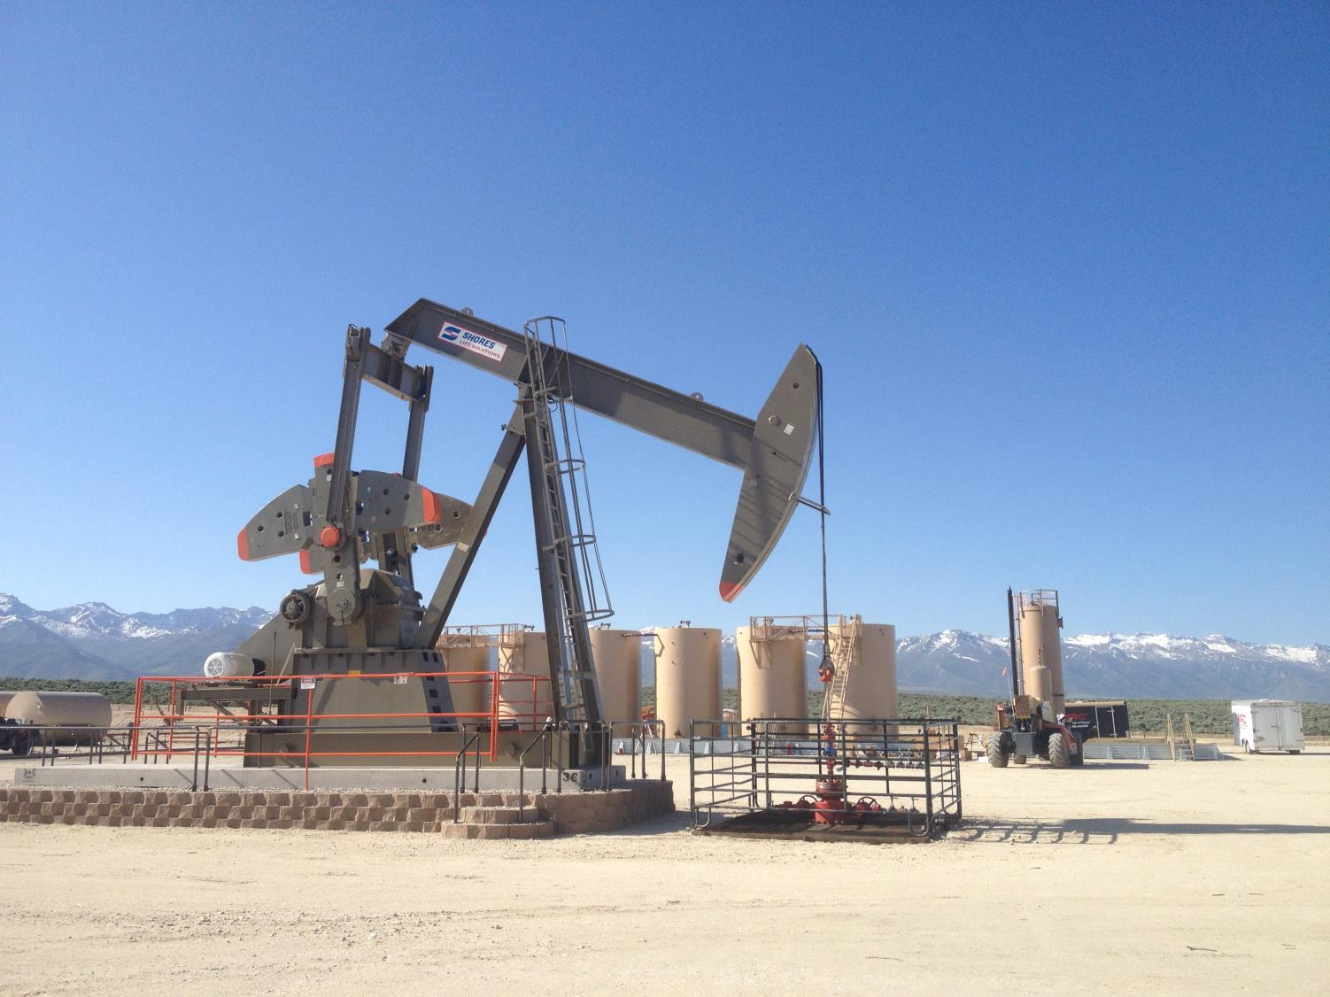
HYDRAULIC FRACTURING (HF) IN NEVADA
Regulations developed by NDOM and NDEP in 2014
Nevada’s HF regulations are one of the most stringent in the U.S.
Wells drilled on Federal lands must adhere to NV regulations. Dual-permitting state.
5 wells had HF treatments in 2014
  1 is a producing well in Eureka County
  2 produced oil but are capped due to economics
No HF treatments in 2015-2016
Higher oil price is necessary to see exploration of tight shale targets
Tight shale targets exist in Elko, Eureka, Nye and White Pine Counties.

Slide 17
Legislatively Required Performance Measures

Slide 18
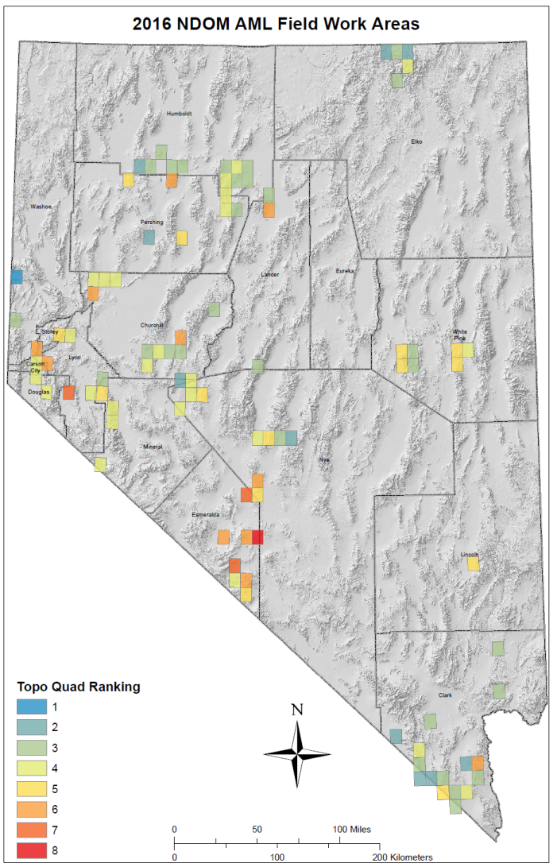
NDOM AML PROGRAM
EACH YEAR HAZARD AREAS ARE PRIORITIZED FOR FIELD WORK BASED ON A RATING SYSTEM
FOR DEGREE OF DANGER AND
ACCESSIBILITY

Slide 19
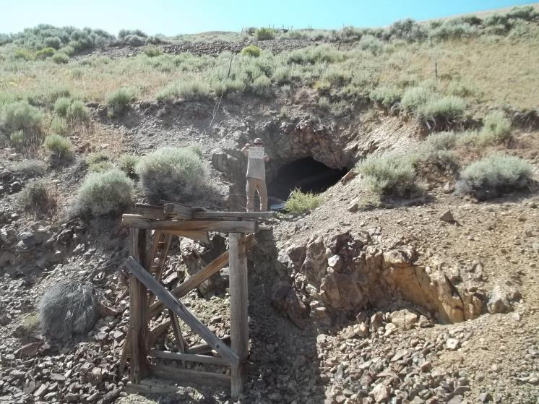
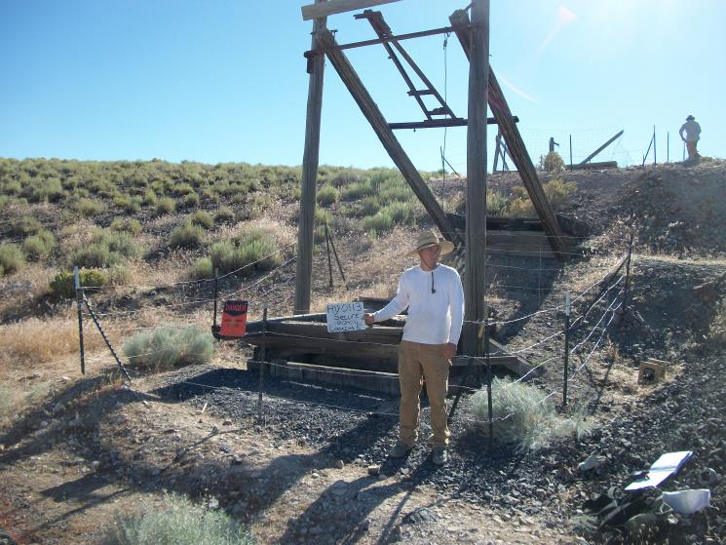
Over 20,000 Hazards Inventoried
Since program inception in 1987, 20,770 abandoned mine hazards logged and 16,842 have been secured.
20,000th Logging
16,000th Securing

Slide 20
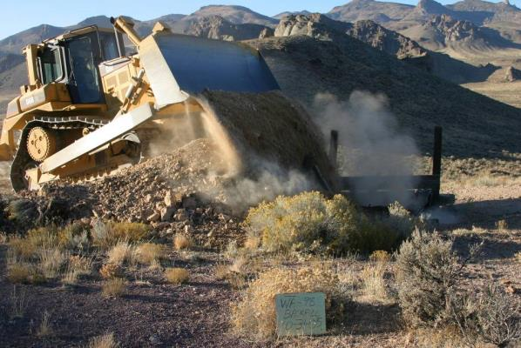
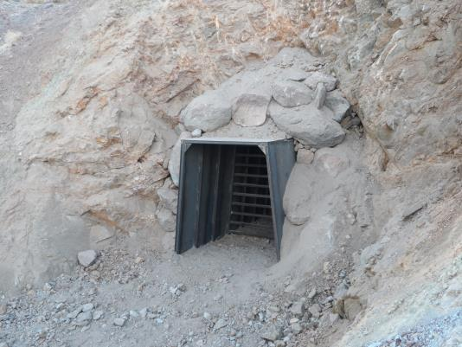
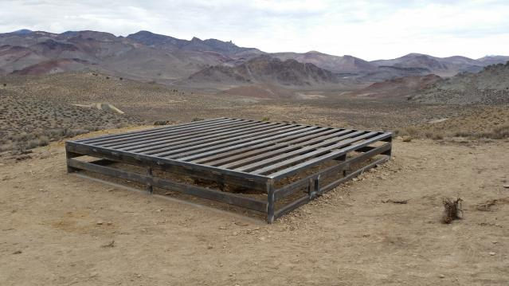
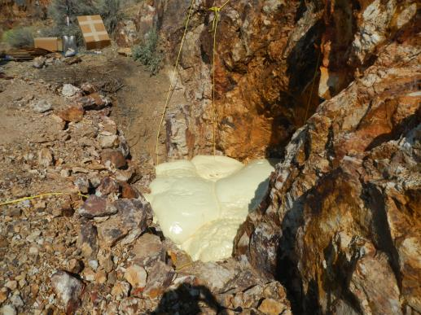
Hard Closure Projects - 206 closures in 2016
Backfills
Polyurethane Foam Plugs
Bat Compatible Closures

Slide 21
POSITIVE RESULTS: SECURING AND PUBLIC EDUCATION EFFORTS HAVE RESULTED
IN “NO REPORTABLE ACCIDENTS OR INJURIES” AT AML FEATURES FOR PAST 3 YEARS.
CONCERN: INCREASING VANDALISM OF FENCING AND GATES REQUIRES RE-VISITS
FOR MAINTENANCE

Slide 22
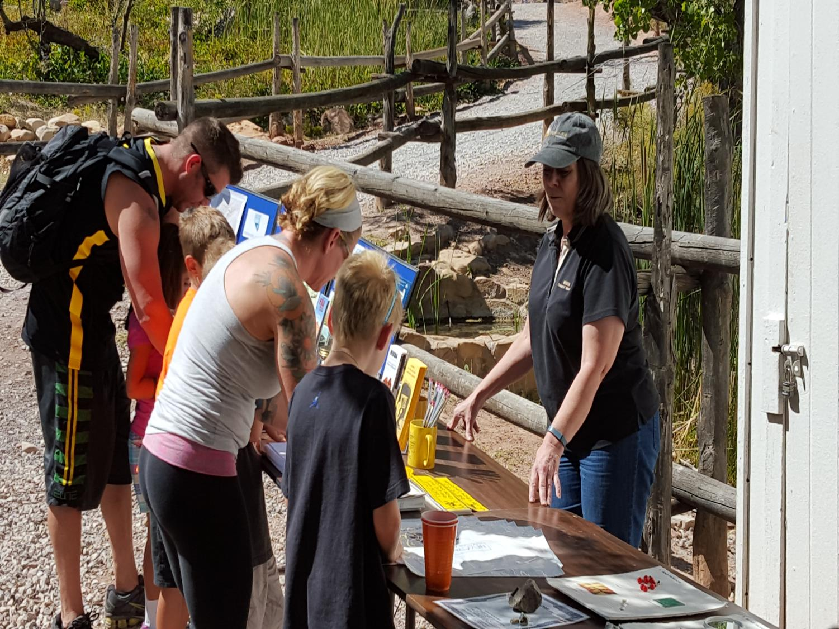
MINERALS EDUCATION STAFF PRESENTATIONS – CALENDAR YEAR 2016
267 PRESENTATIONS CONDUCTED
  169 K-12 CLASSROOM PRESENTATIONS TO 5,698 STUDENTS
  25 PRESENTATIONS ON NEVADA MINING & OIL/GAS/GEOTHERMAL PRODUCTION TO CIVIC GROUPS, CLUBS AND ORGANIZATIONS
  5 MEDIA PRESENTATIONS
  158 PRESENTATIONS IN NORTHERN NEVADA, 109 IN SOUTHERN NEVADA
CALL US IF YOU NEED A PRESENTATION FOR CLASSROOMS, PROFESSIONAL OR CIVIC GROUPS
  Classroom: minerals & rocks, geology, mining, abandoned mine safety
  Civic group & trade associations: Nevada mineral production, geothermal/oil/gas production, lithium updates.
2018-19: MOVING FIELD SPECIALIST VACANCY TO LV OFFICE
  Demand for classroom time and abandoned mine land activities

Slide 23
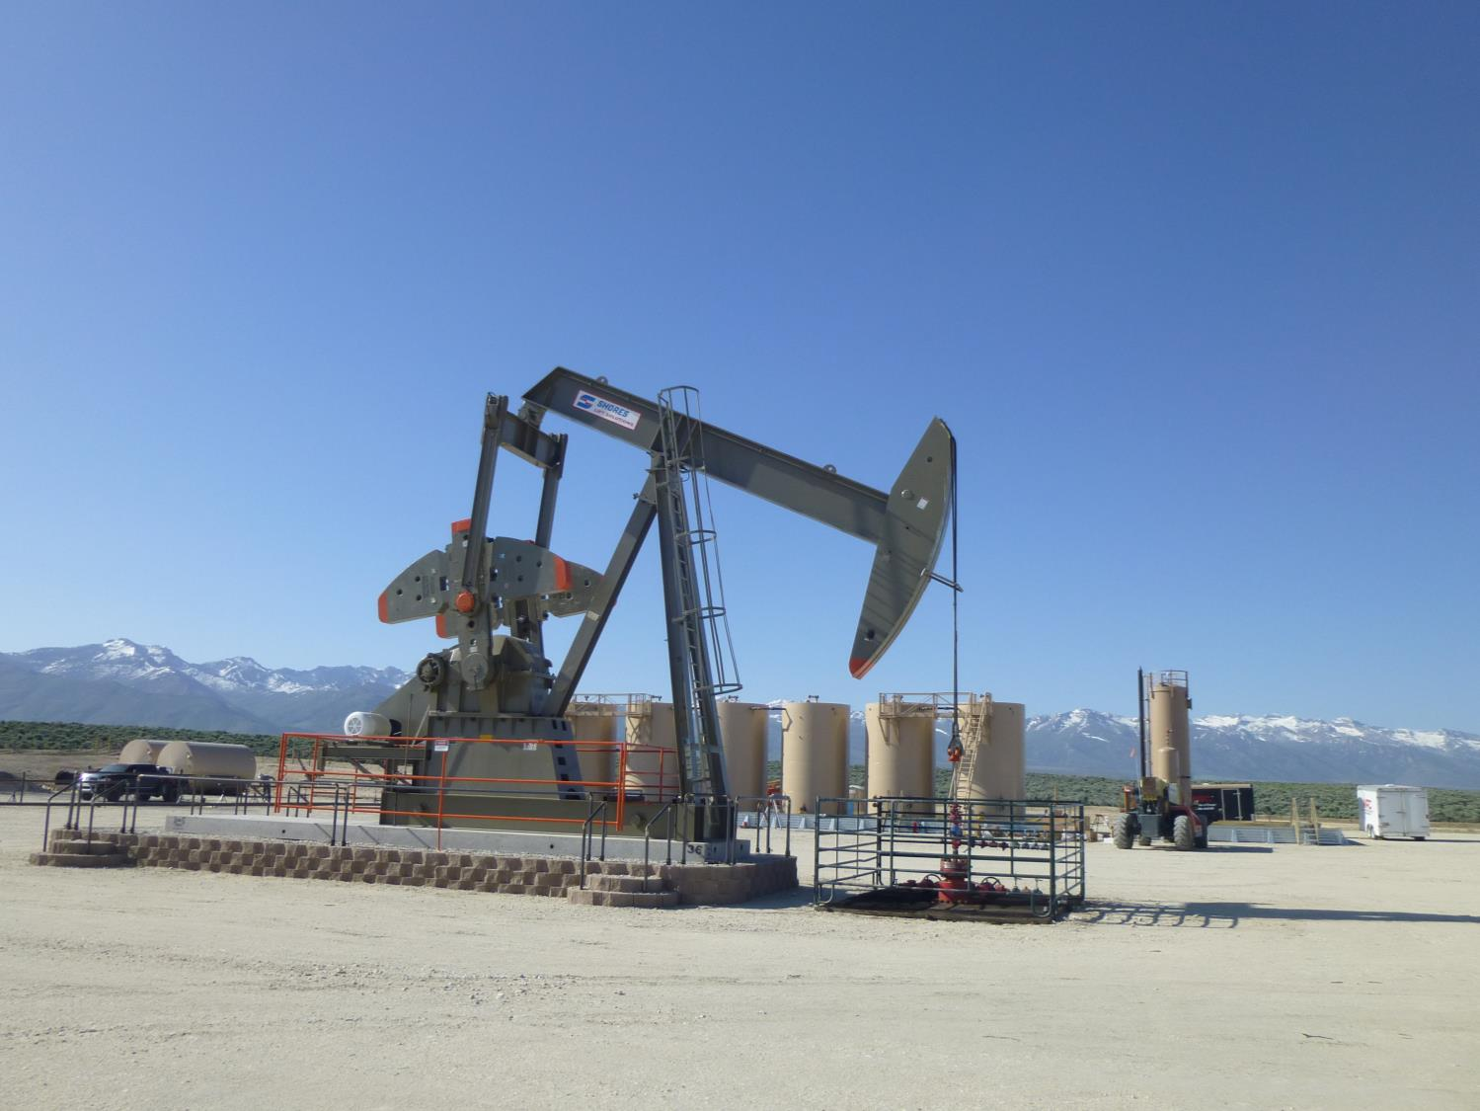
2016-17 ACCOMPLISHMENTS
Updated Oil and Gas regulations in NAC 522
Updated Geothermal regulations in NAC 534A
Developed web-fillable claim forms in coordination with county recorders NAC 517
Updated Abandoned Mine Lands regulations in NAC 513
Developed searchable database of all oil and geothermal wells in State
Improved delivery of information to public and industry on web site, public presentations and K-12 classroom educational materials

Slide 24
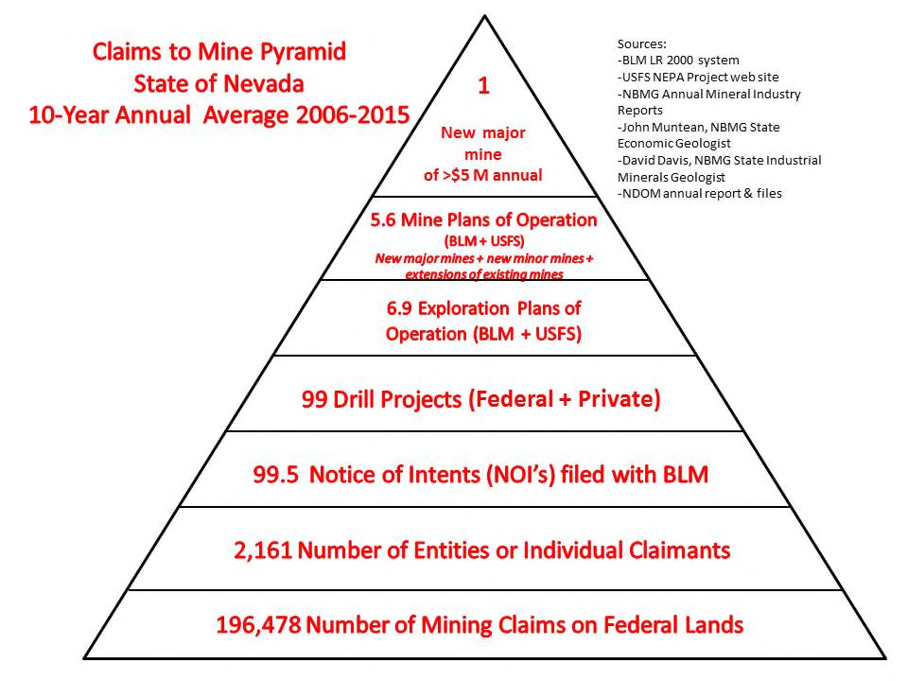


Slide 25
